Slide 1

Hypothesis Testing
The scientific method in action
Yordan Darakchiev
Technical Trainer
iordan93@gmail.com

Slide 2
sli.do #MathForDevs

Slide 3
Table of Contents
Confidence intervals
Confidence level
Hypothesis tests
Z-test
t-test (one-sample, two-sample)
Hypothesis tests of many variables
ANOVA
Chi-squared
p-value misconceptions

Slide 4
Confidence Intervals
Being confident is important

Slide 5
Confidence Intervals
In an experiment, we can't observe the variables' true values directly
We observe other values
We make assumptions as to how they are distributed
We can estimate the true value
Law of large numbers: when our sample is big enough, the sample parameters approach the population parameters
With continuous values, it's useless to say that the mean is equal to a certain value (why?)
Confidence interval – a range of values that we're fairly sure contains the true value
How confident? A matter of choice
Confidence level – the probability that the value falls within the interval

Slide 6
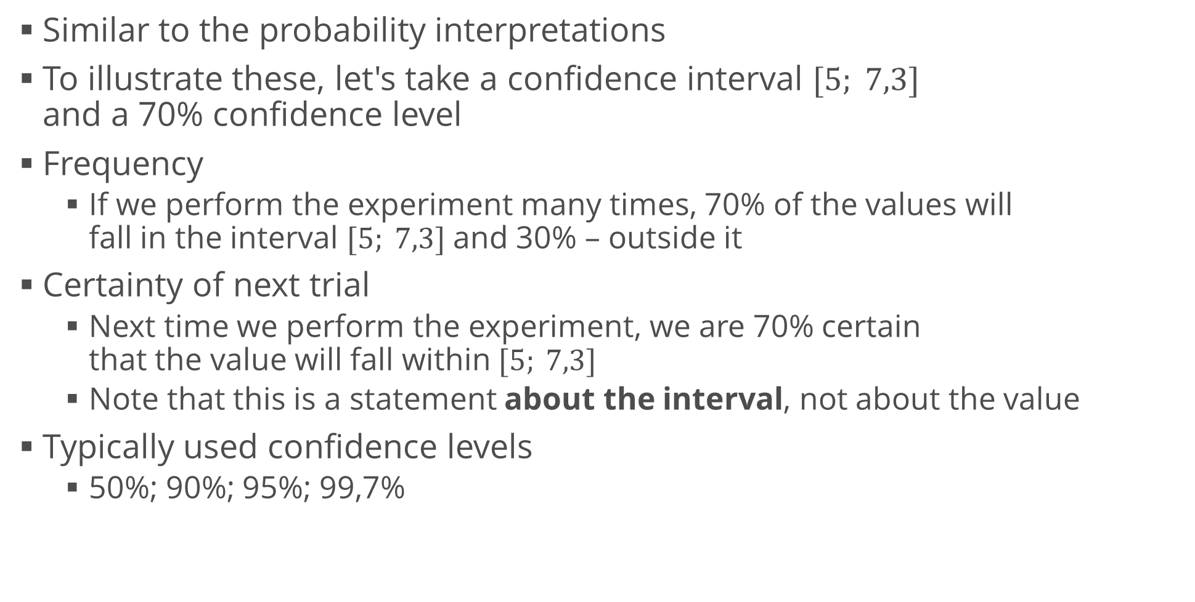
Confidence Intervals – Interpretation
Similar to the probability interpretations
To illustrate these, let's take a confidence interval $[5; 7,3]$ and a 70% confidence level
Frequency
If we perform the experiment many times, 70% of the values will fall in the interval $[5; 7,3]$ and 30% – outside it
Certainty of next trial
Next time we perform the experiment, we are 70% certain that the value will fall within $[5; 7,3]$
Note that this is a statement about the interval, not about the value
Typically used confidence levels
50%; 90%; 95%; 99,7%

Slide 7
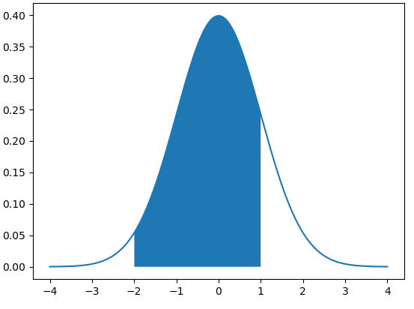
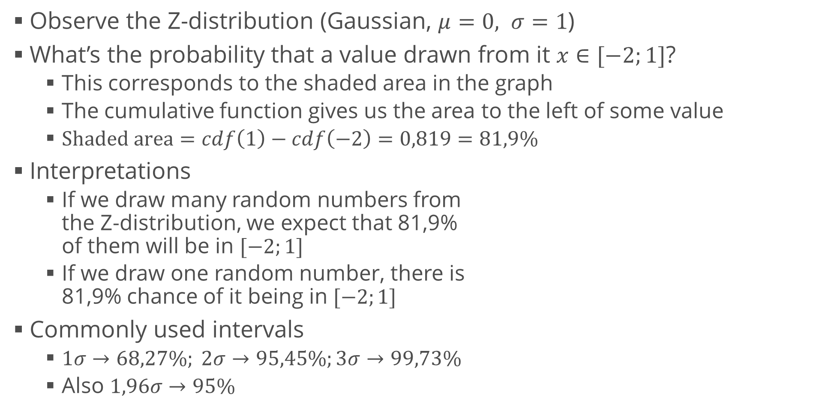
Confidence Intervals and Z-Scores
Observe the Z-distribution (Gaussian, $μ=0, σ=1$)
What’s the probability that a value drawn from it $x∈[−2;1]$?
This corresponds to the shaded area in the graph
The cumulative function gives us the area to the left of some value
$Shaded area=cdf\left(1\right)−cdf\left(−2\right)=0,819=81,9\%$
Interpretations
If we draw many random numbers from the Z-distribution, we expect that 81,9% of them will be in $[−2;1]$
If we draw one random number, there is 81,9% chance of it being in $[−2;1]$
Commonly used intervals
$1σ→68,27\%; 2σ→95,45\%;3σ→99,73\%$
Also $1,96σ→95\%$

Slide 8
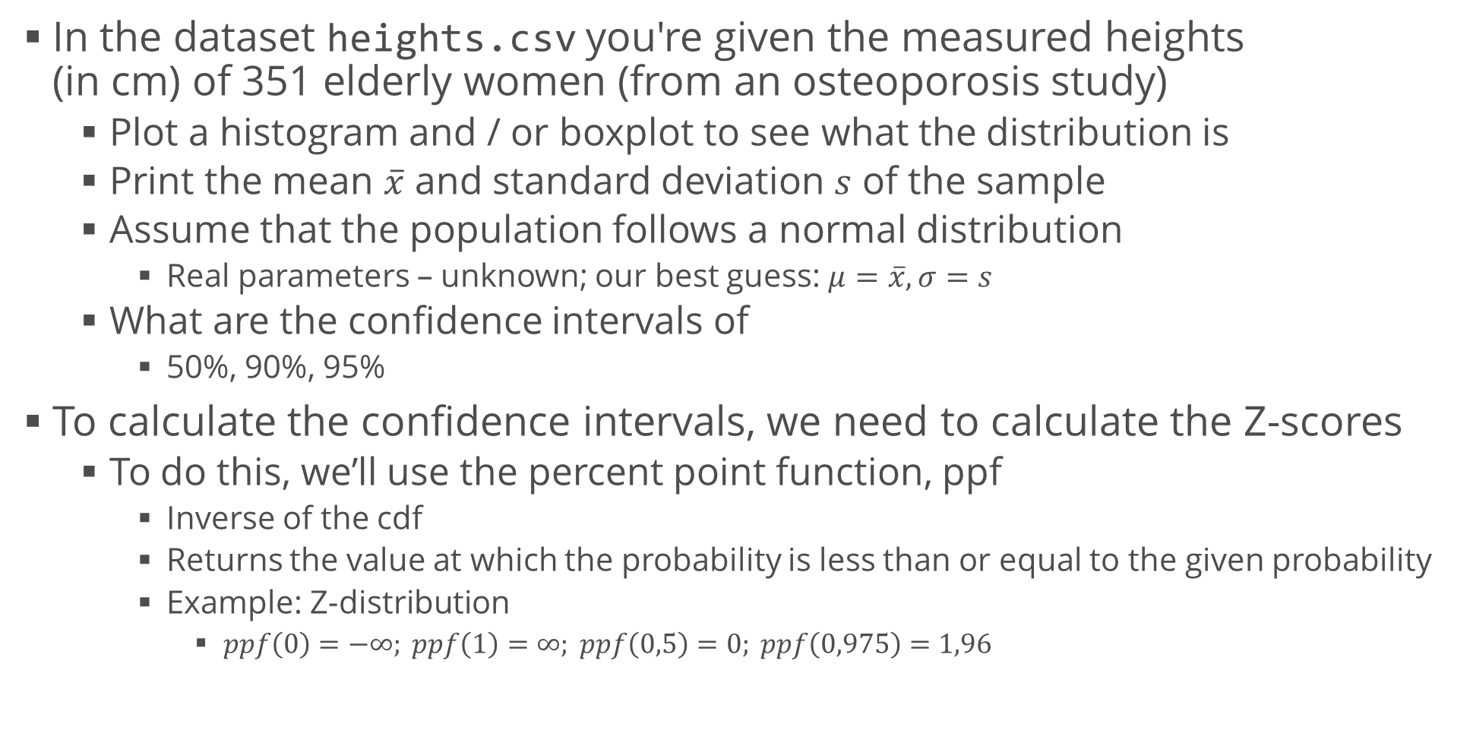
Confidence Intervals: Example
In the dataset heights.csv you're given the measured heights (in cm) of 351 elderly women (from an osteoporosis study)
Plot a histogram and / or boxplot to see what the distribution is
Print the mean $\overline{x}$ and standard deviation $s$ of the sample
Assume that the population follows a normal distribution
Real parameters – unknown; our best guess: $μ=\overline{x}, σ=s$
What are the confidence intervals of
50%, 90%, 95%
To calculate the confidence intervals, we need to calculate the Z-scores
To do this, we’ll use the percent point function, ppf
Inverse of the cdf
Returns the value at which the probability is less than or equal to the given probability
Example: Z-distribution
$ppf\left(0\right)=−∞; ppf\left(1\right)=∞; ppf\left(0,5\right)=0; ppf\left(0,975\right)=1,96$

Slide 9
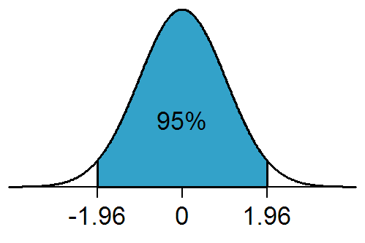

Confidence Intervals Example (2)
Note that once again we need to subtract the left white region
Area of shaded region: $p$ (e.g. $p=0,95$)
Area of both tails: $1−p$
Percentage point of left tail: $\frac{1−p}{2}$
Percentage point of right tail: $\frac{1−p}{2}+p=\frac{1−p+2p}{2}=\frac{1+p}{2}$
import scipy.stats as st
def get_real_confidence_interval(probability, mean, std):
lower_area = (1 - probability) / 2
upper_area = (1 + probability) / 2
return [
st.norm.ppf(lower_area, mean, std),
st.norm.ppf(upper_area, mean, std)]

Slide 10
Testing Hypotheses
The scientific method in action

Slide 11
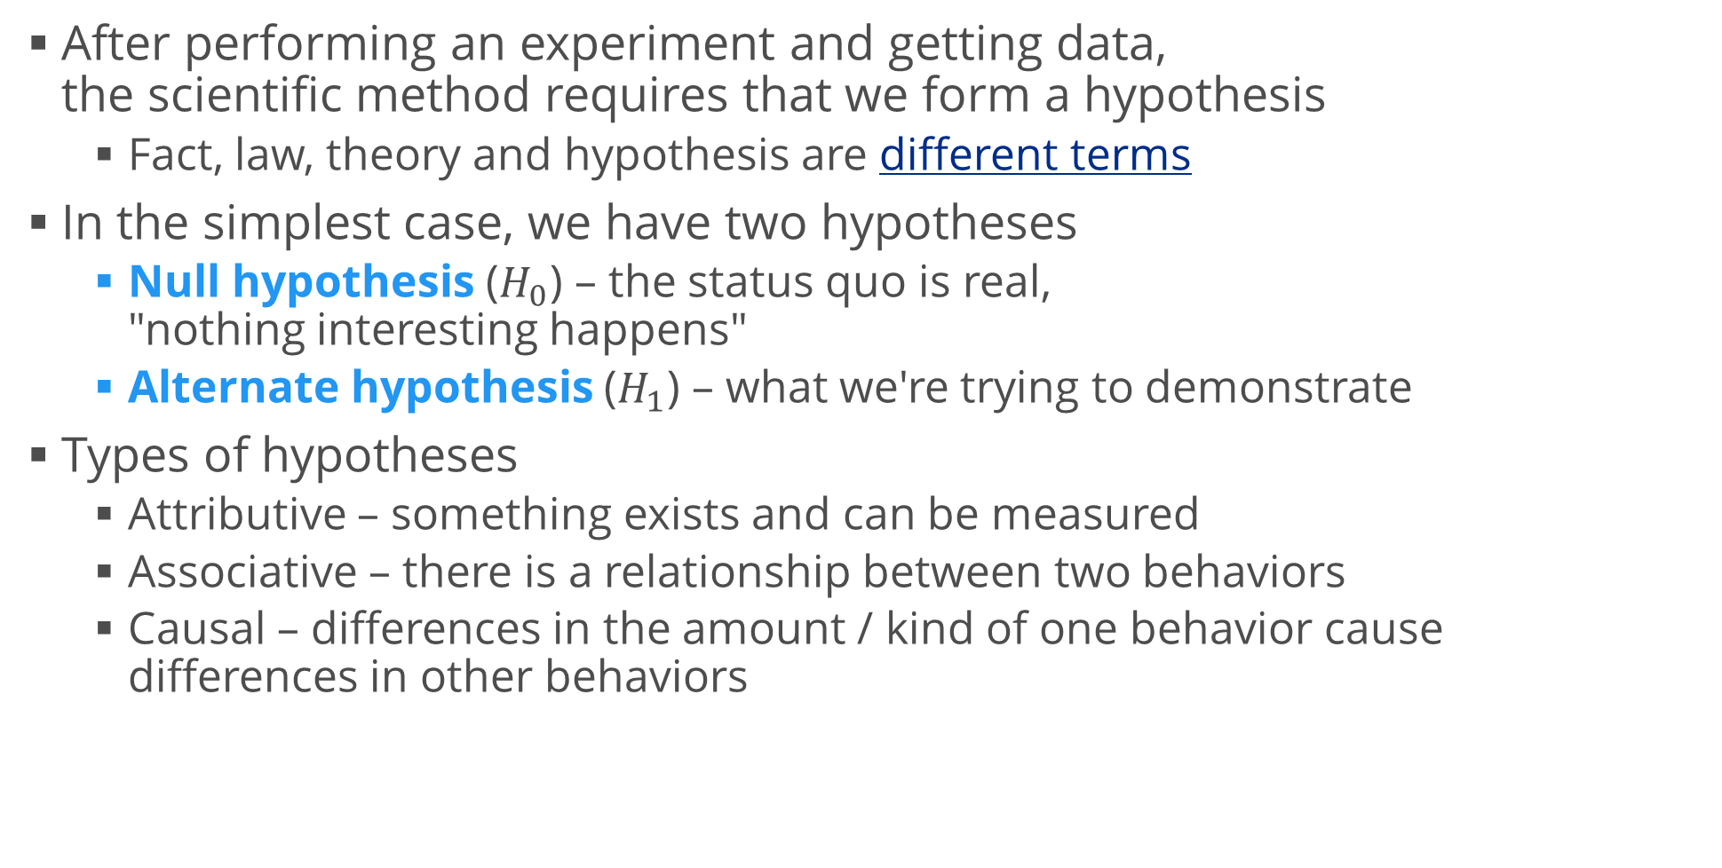
Hypotheses
After performing an experiment and getting data, the scientific method requires that we form a hypothesis
Fact, law, theory and hypothesis are different terms
In the simplest case, we have two hypotheses
Null hypothesis ($H_{0}$) – the status quo is real, "nothing interesting happens"
Alternate hypothesis ($H_{1}$) – what we're trying to demonstrate
Types of hypotheses
Attributive – something exists and can be measured
Associative – there is a relationship between two behaviors
Causal – differences in the amount / kind of one behavior cause differences in other behaviors

Slide 12
Hypotheses – Examples
Examples of hypotheses – study of Disneyland visitors
Attributive
Most of the population has heard of Disneyland
Disneyland visitors are diverse in demographics
Associative
Income level is correlated with visiting Disneyland
People who live closer to Disneyland are more apt to visit Disneyland
Causal
Frequent exposure to Disneyland advertising results in increased attendance
Discounting tickets for local residents produces an increase in visitor numbers
Note that attributive hypotheses involve one variable (univariate) while associative and causal hypotheses involve two variables (bivariate)

Slide 13
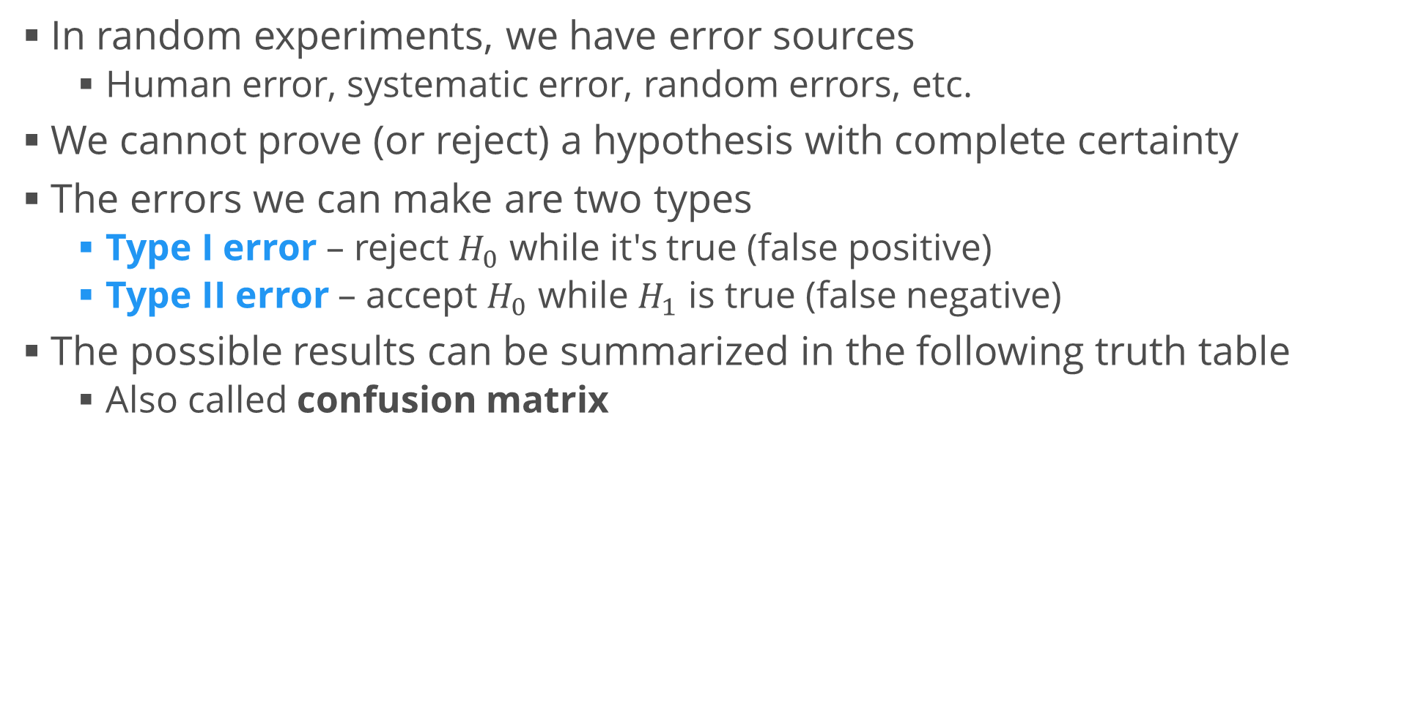
Testing a Hypothesis
In random experiments, we have error sources
Human error, systematic error, random errors, etc.
We cannot prove (or reject) a hypothesis with complete certainty
The errors we can make are two types
Type I error – reject $H_{0}$ while it's true (false positive)
Type II error – accept $H_{0}$ while $H_{1}$ is true (false negative)
The possible results can be summarized in the following truth table
Also called confusion matrix
 |  | Action
 |  | Don't reject H₀ | Reject H₀
Reality | H₀ true | TN true negative | FP (type I error) false positive
 | H₀ false | FN (type II error) false negative | TP true positive

Slide 14
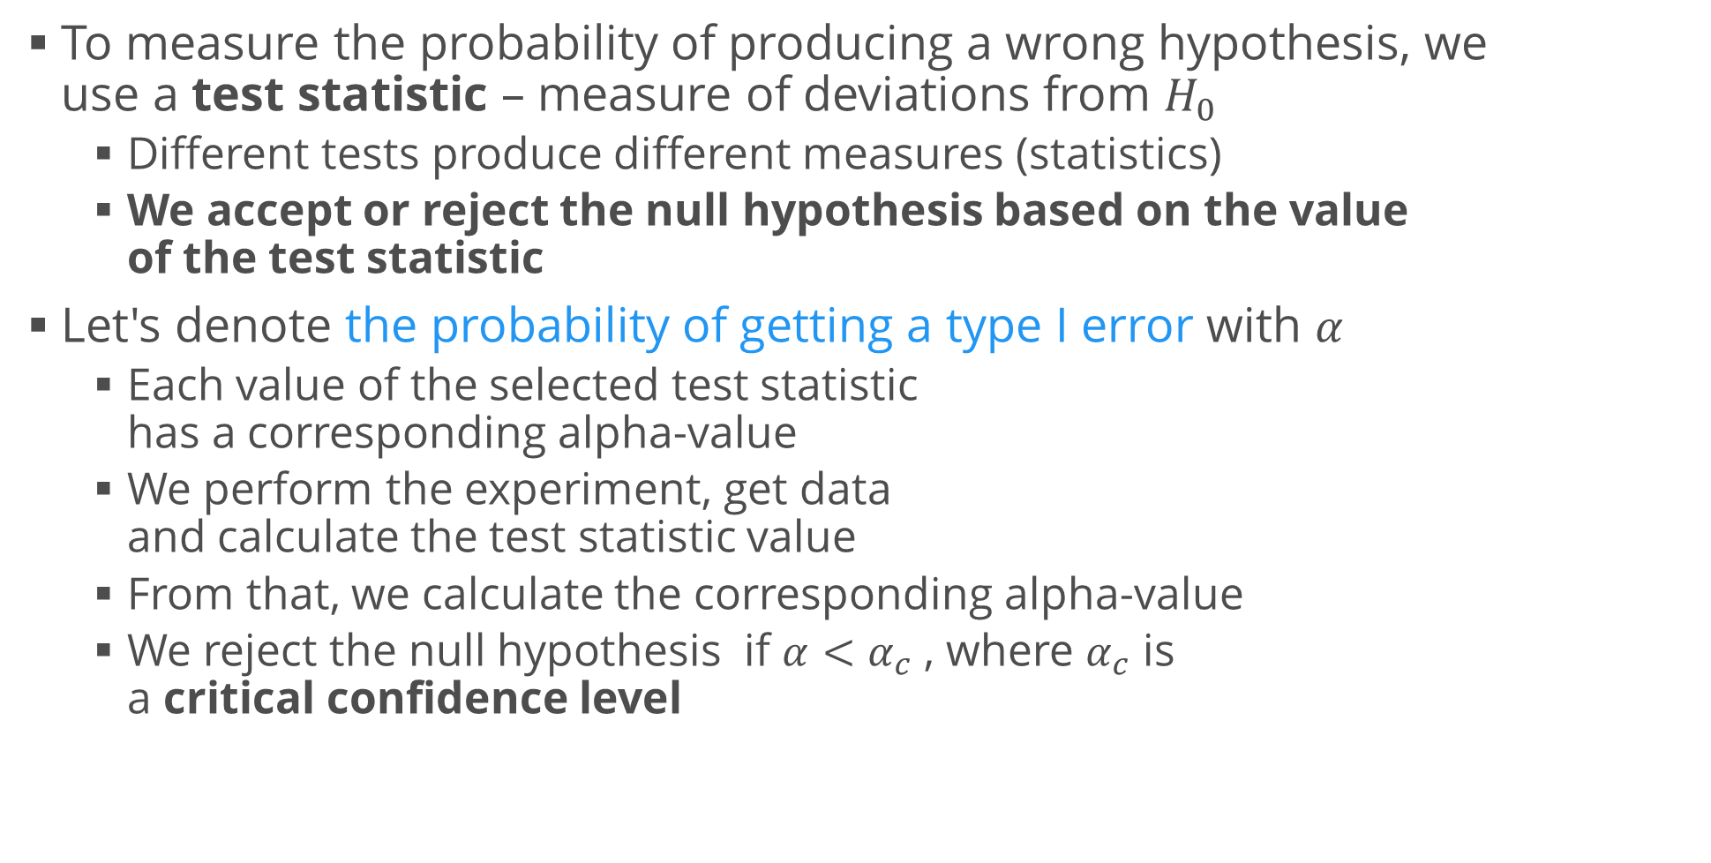
Testing a Hypothesis (2)
To measure the probability of producing a wrong hypothesis, we use a test statistic – measure of deviations from $H_{0}$
Different tests produce different measures (statistics)
We accept or reject the null hypothesis based on the value of the test statistic
Let's denote the probability of getting a type I error with $α$
Each value of the selected test statistic has a corresponding alpha-value
We perform the experiment, get data and calculate the test statistic value
From that, we calculate the corresponding alpha-value
We reject the null hypothesis if $α<α_{c}$ , where $α_{c}$ is a critical confidence level

Slide 15
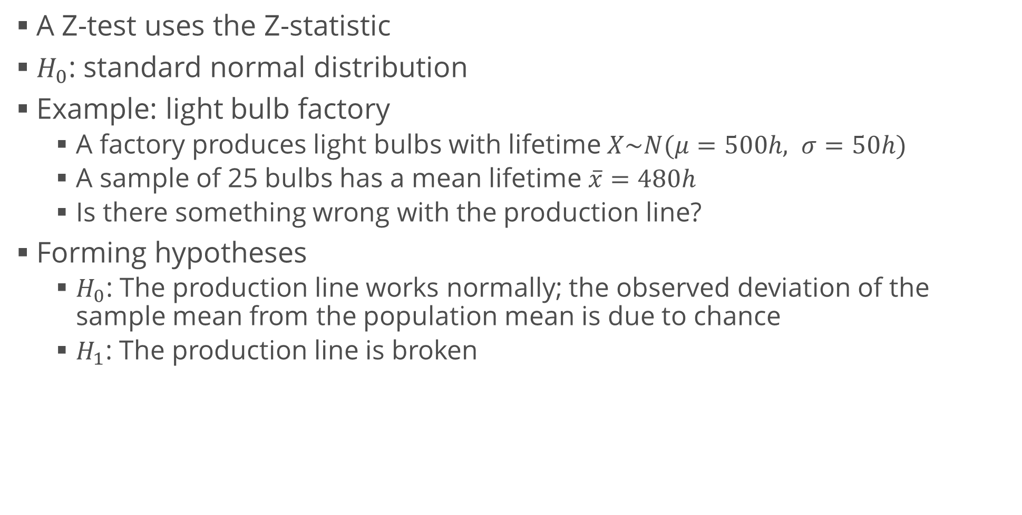
Z-test
A Z-test uses the Z-statistic
$H_{0}$: standard normal distribution
Example: light bulb factory
A factory produces light bulbs with lifetime $X\sim N(μ=500h, σ=50h)$
A sample of 25 bulbs has a mean lifetime $\overline{x}=480h$
Is there something wrong with the production line?
Forming hypotheses
$H_{0}$: The production line works normally; the observed deviation of the sample mean from the population mean is due to chance
$H_{1}$: The production line is broken

Slide 16
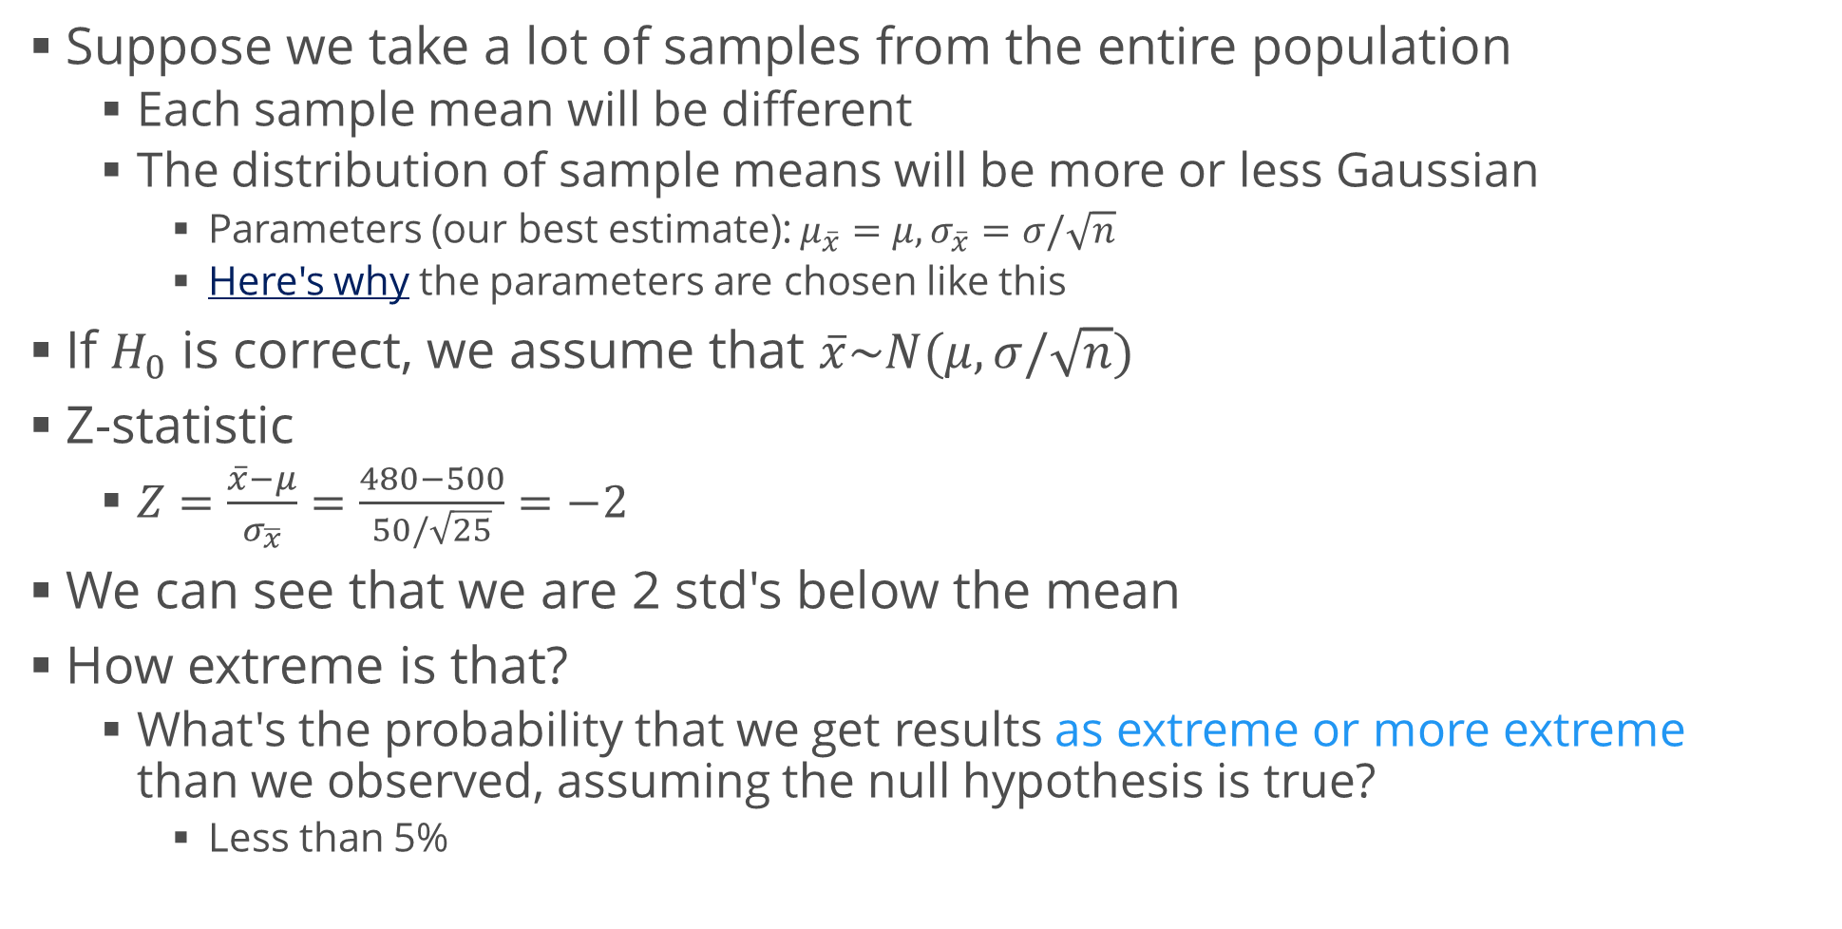
Z-test (2)
Suppose we take a lot of samples from the entire population
Each sample mean will be different
The distribution of sample means will be more or less Gaussian
Parameters (our best estimate): $μ_{\overline{x}}=μ, σ_{\overline{x}}=σ/\sqrt{n}$
Here's why the parameters are chosen like this
If $H_{0}$ is correct, we assume that $\overline{x}\sim N(μ,σ/\sqrt{n})$
Z-statistic
$Z=\frac{\overline{x}−μ}{σ_{\overline{x}}}=\frac{480−500}{50/\sqrt{25}}=−2$
We can see that we are 2 std's below the mean
How extreme is that?
What's the probability that we get results as extreme or more extreme than we observed, assuming the null hypothesis is true?
Less than 5%

Slide 17
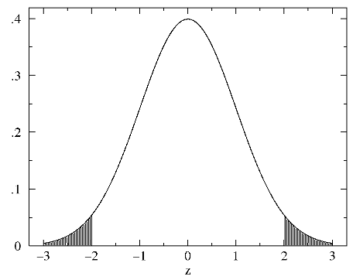
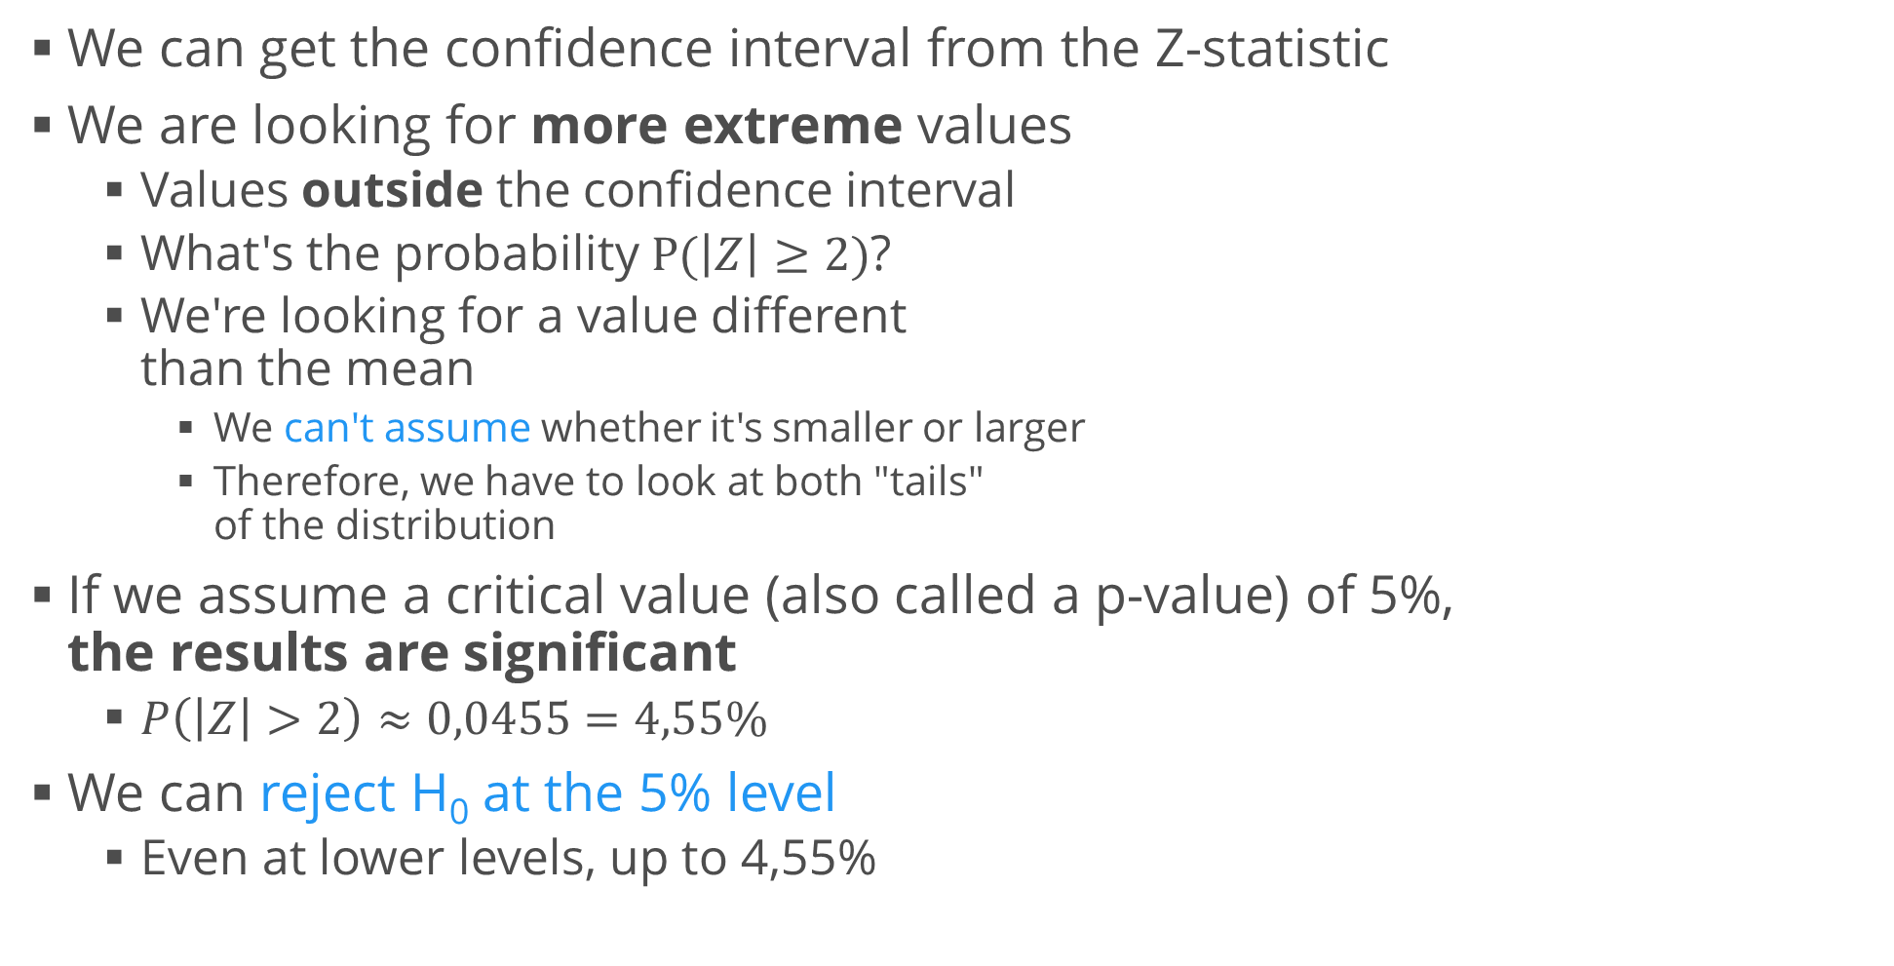
Two-tailed Z-test
We can get the confidence interval from the Z-statistic
We are looking for more extreme values
Values outside the confidence interval
What's the probability $P(\left|Z\right|≥2)$?
We're looking for a value different than the mean
We can't assume whether it's smaller or larger
Therefore, we have to look at both "tails" of the distribution
If we assume a critical value (also called a p-value) of 5%, the results are significant
$P\left(\left|Z\right|>2\right)≈0,0455=4,55\%$
We can reject H₀ at the 5% level
Even at lower levels, up to 4,55%

Slide 18
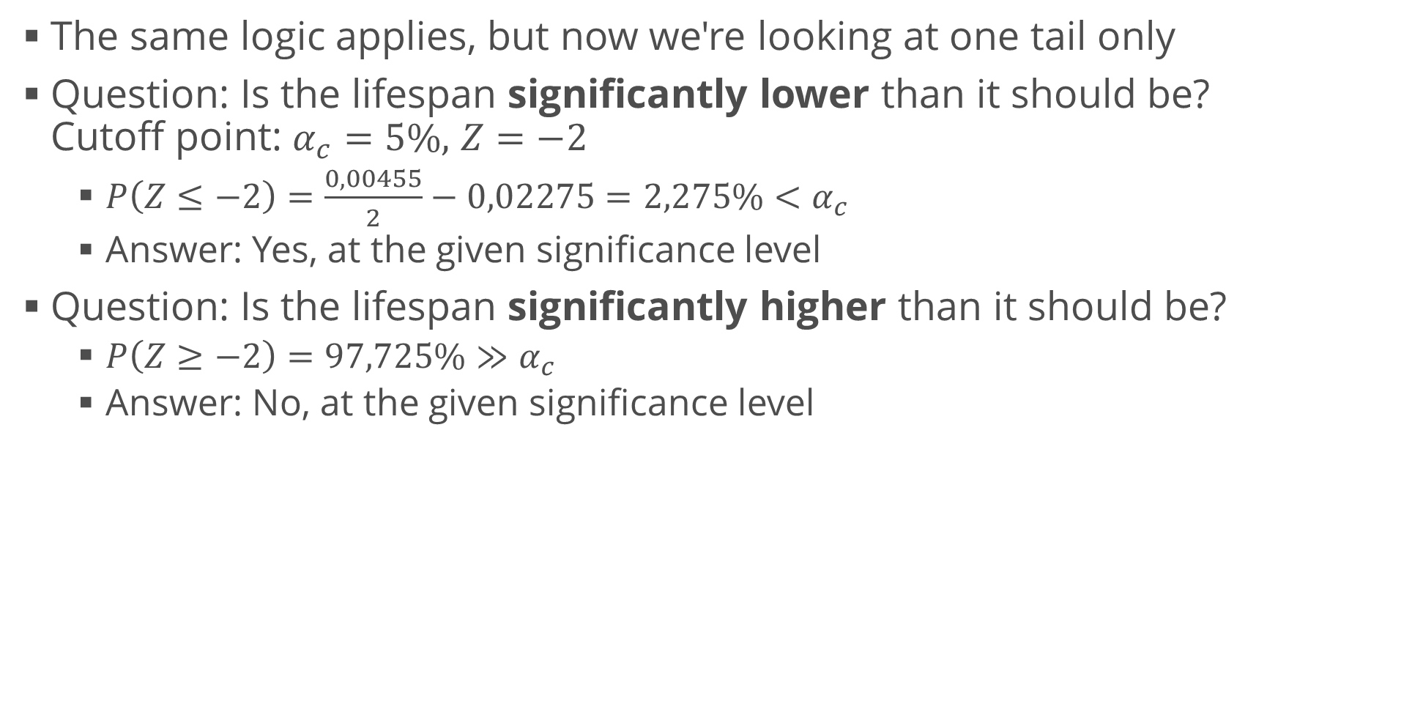
One-tailed Z-test
The same logic applies, but now we're looking at one tail only
Question: Is the lifespan significantly lower than it should be? Cutoff point: $α_{c}=5\%,$ $Z=−2$
$P\left(Z≤−2\right)=\frac{0,00455}{2}−0,02275=2,275\%<α_{c}$
Answer: Yes, at the given significance level
Question: Is the lifespan significantly higher than it should be?
$P\left(Z≥−2\right)=97,725\%≫α_{c}$
Answer: No, at the given significance level

Slide 19
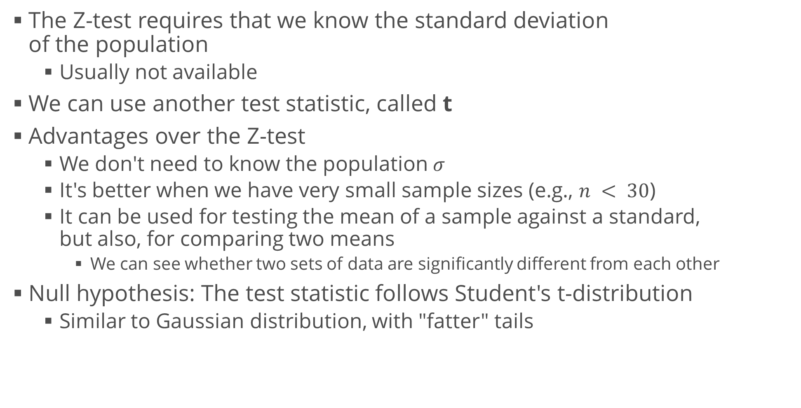
t-test
The Z-test requires that we know the standard deviation of the population
Usually not available
We can use another test statistic, called t
Advantages over the Z-test
We don't need to know the population $σ$
It's better when we have very small sample sizes (e.g., $n < 30$)
It can be used for testing the mean of a sample against a standard, but also, for comparing two means
We can see whether two sets of data are significantly different from each other
Null hypothesis: The test statistic follows Student's t-distribution
Similar to Gaussian distribution, with "fatter" tails

Slide 20
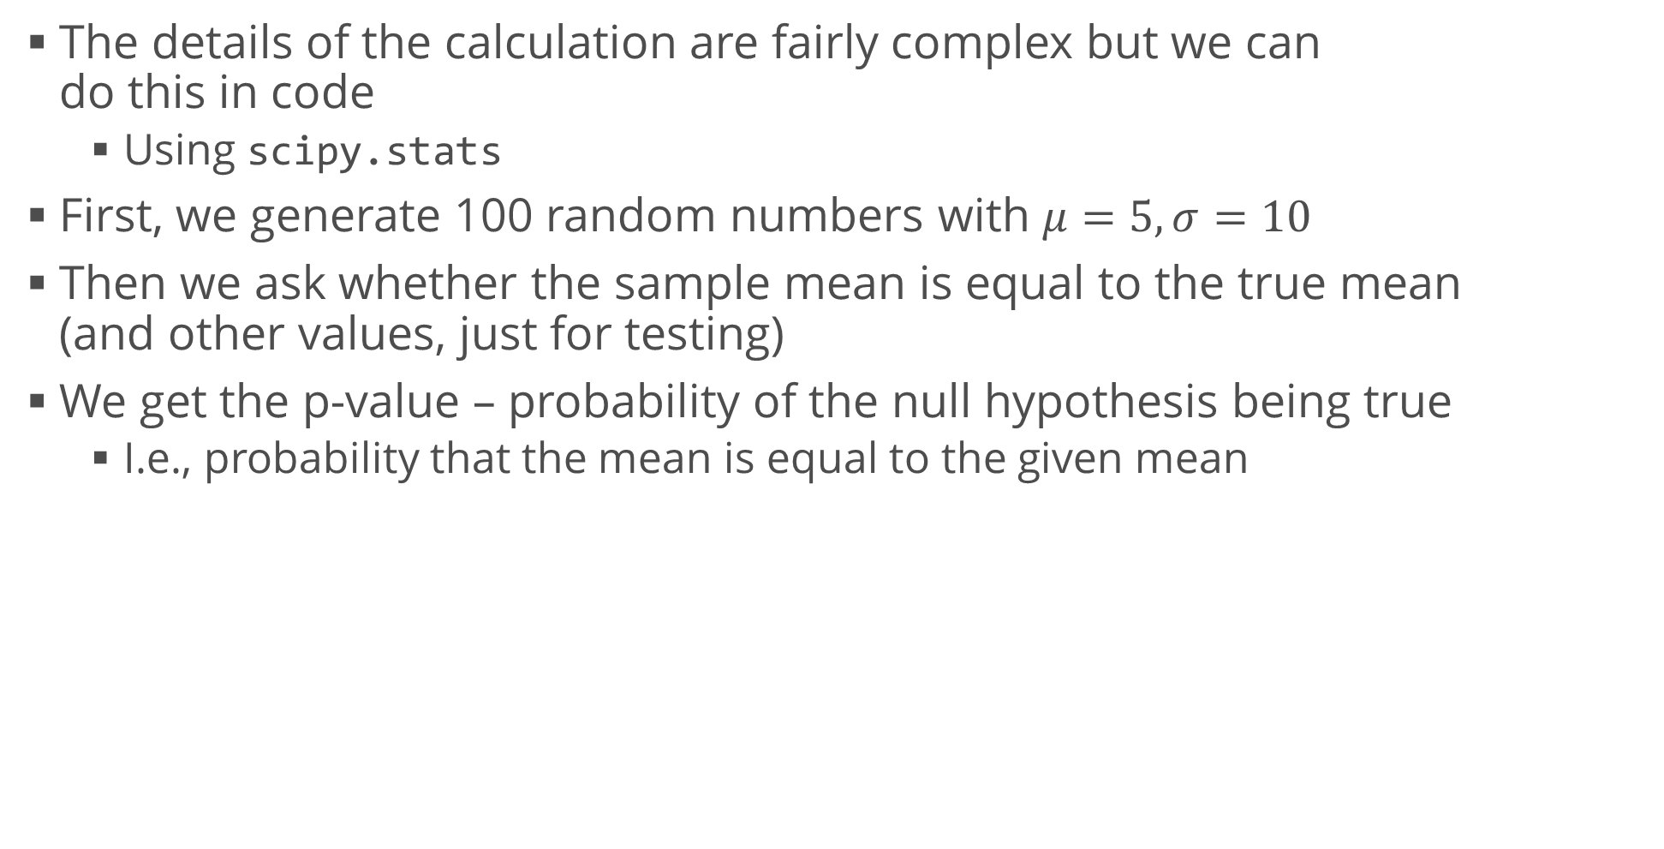
One-Sample t-test
The details of the calculation are fairly complex but we can do this in code
Using scipy.stats
First, we generate 100 random numbers with $μ=5,σ=10$
Then we ask whether the sample mean is equal to the true mean (and other values, just for testing)
We get the p-value – probability of the null hypothesis being true
I.e., probability that the mean is equal to the given mean
sample_data = st.norm.rvs(5, 10, 100)
print(st.ttest_1samp(sample_data, 5).pvalue) # 0.9301
print(st.ttest_1samp(sample_data, 4).pvalue) # 0.3352
print(st.ttest_1samp(sample_data, 0).pvalue) # 1.104e-6

Slide 21
Independent Two-Sample t-test
We compare two independent distributions
We want to see whether they have the same mean
We assume equal variances (scipy can also do tests with unequal variances – important when sample sizes differ)
Example: Grain size
We are given data (in grain_data.csv) of grain sizes from two different farms
Do they differ significantly (at the 95% level)?
* We can also plot histograms to see what the distributions look like
grain_data = ...
st.ttest_ind(grain_data.GreatNorthern, grain_data.BigFour)
# Ttest_indResult(statistic=1.312336706487564, # pvalue=0.20792200785311768)

Slide 22
Paired Two-Sample t-test
We compare two distributions
Observations in samples can be paired
Examples – before / after observations; comparison between two different treatments applied to the same subjects
Example: Drinking water
We are given data (in water_data.csv) of Zn concentration in surface and bottom water at 10 different locations
Does the true average concentration in bottom water exceed that of top water?
We use a paired t-test because the samples are from the same locations
It reduces experimental error (and provides stronger evidence)
water_data = ...
# We use a one-tailed t-test
st.ttest_rel(water_data.surface, water_data.bottom).pvalue / 2
# 0.00044555772891127738

Slide 23
Generalizations to More Variables
Sometimes it's not enough to compare two distributions
We may want to compare multiple distributions against the same null hypothesis
E.g., how is the percentage of smokers distributed by income and age?
Other times, we create a model and want to evaluate it
E.g., a linear regression
We can explain some of the variance in the sample
There are other tests to perform these "checks"
ANOVA (Analysis of Variance) – useful for grouped data
Observe the variance inside groups and between groups
Chi-square(d) test – can be applied to categorical data
Two common types
How good a model is (goodness of fit)
Whether two variables are independent

Slide 24
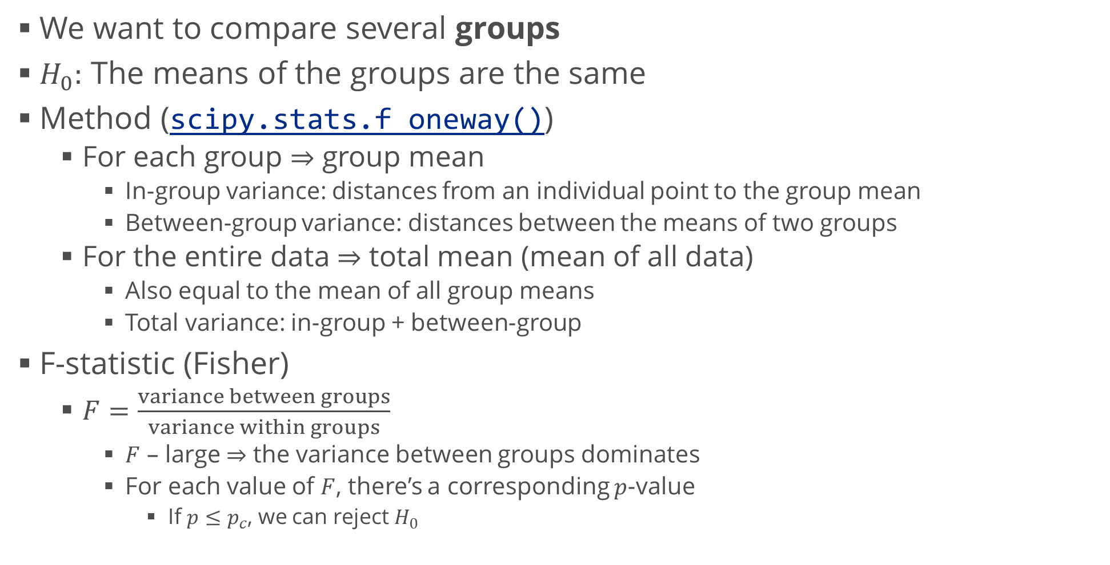
Analysis of Variance (ANOVA)
We want to compare several groups
$H_{0}:$ The means of the groups are the same
Method (scipy.stats.f_oneway())
For each group $⇒$ group mean
In-group variance: distances from an individual point to the group mean
Between-group variance: distances between the means of two groups
For the entire data $⇒$ total mean (mean of all data)
Also equal to the mean of all group means
Total variance: in-group + between-group
F-statistic (Fisher)
$F=\frac{variance between groups}{variance within groups}$
$F$ – large $⇒$ the variance between groups dominates
For each value of $F$, there’s a corresponding $p$-value
If $p≤p_{c}$, we can reject $H_{0}$

Slide 25
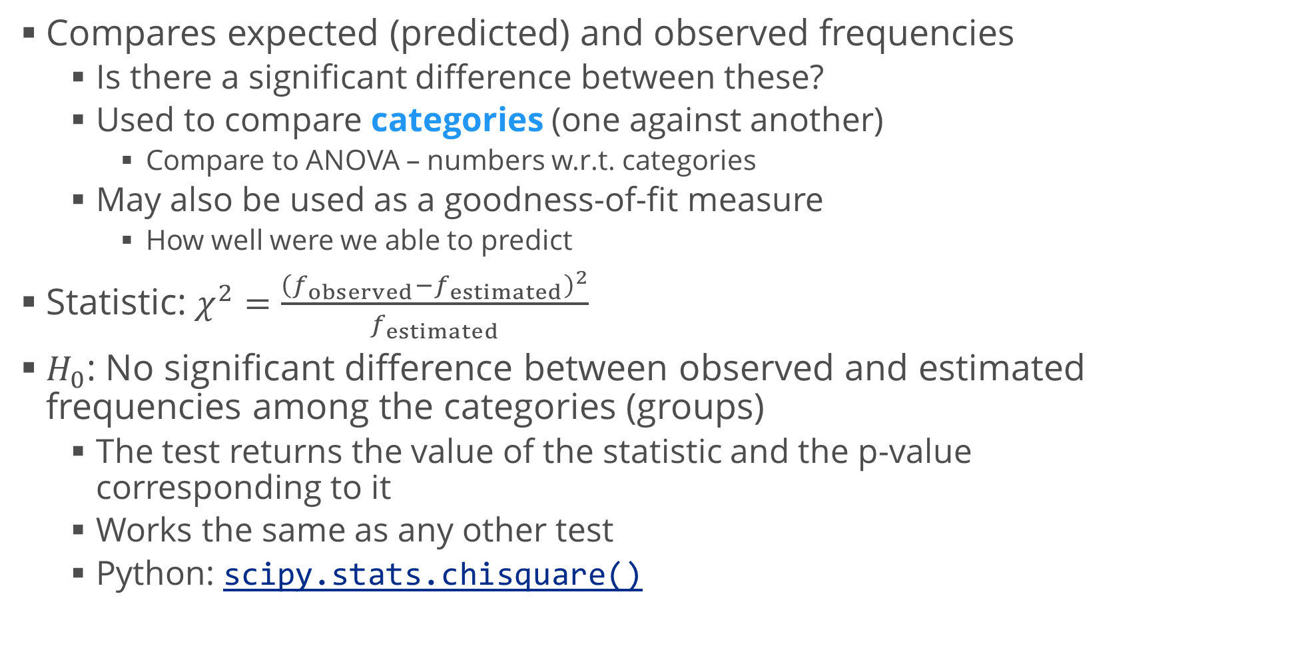
Chi-Squared ($χ^{2}$) Test
Compares expected (predicted) and observed frequencies
Is there a significant difference between these?
Used to compare categories (one against another)
Compare to ANOVA – numbers w.r.t. categories
May also be used as a goodness-of-fit measure
How well were we able to predict
Statistic: $χ^{2}=\frac{{\left(f_{observed}−f_{estimated}\right)}^{2}}{f_{estimated}}$
$H_{0}$: No significant difference between observed and estimated frequencies among the categories (groups)
The test returns the value of the statistic and the p-value corresponding to it
Works the same as any other test
Python: scipy.stats.chisquare()

Slide 26
Common Misconceptions
Because everyone can be wrong

Slide 27
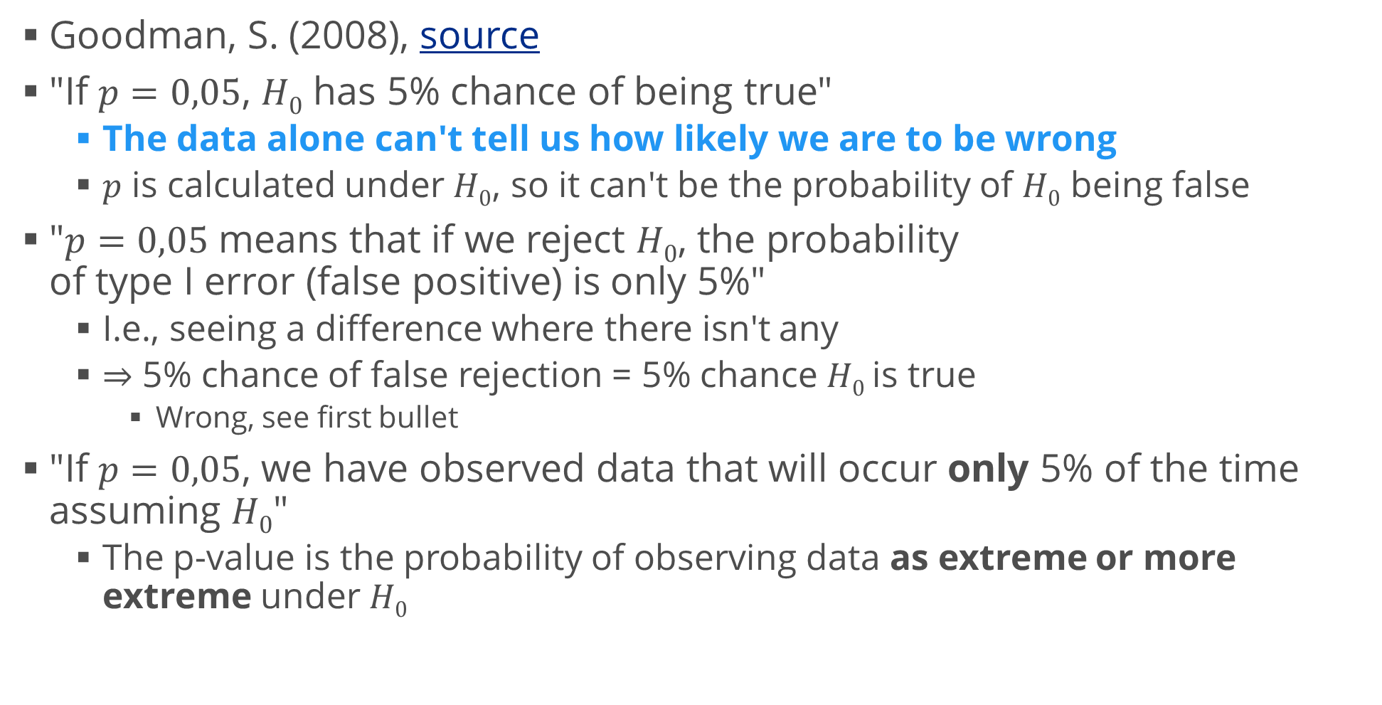
Some p-value Misconceptions
Goodman, S. (2008), source
"If $p=0,05$, $H0$ has 5% chance of being true"
The data alone can't tell us how likely we are to be wrong
$p$ is calculated under $H0$, so it can't be the probability of $H0$ being false
"$p=0,05$ means that if we reject $H0$, the probability of type I error (false positive) is only 5%"
I.e., seeing a difference where there isn't any
$⇒$ 5% chance of false rejection = 5% chance $H0$ is true
Wrong, see first bullet
"If $p=0,05$, we have observed data that will occur only 5% of the time assuming $H0$"
The p-value is the probability of observing data as extreme or more extreme under $H0$

Slide 28
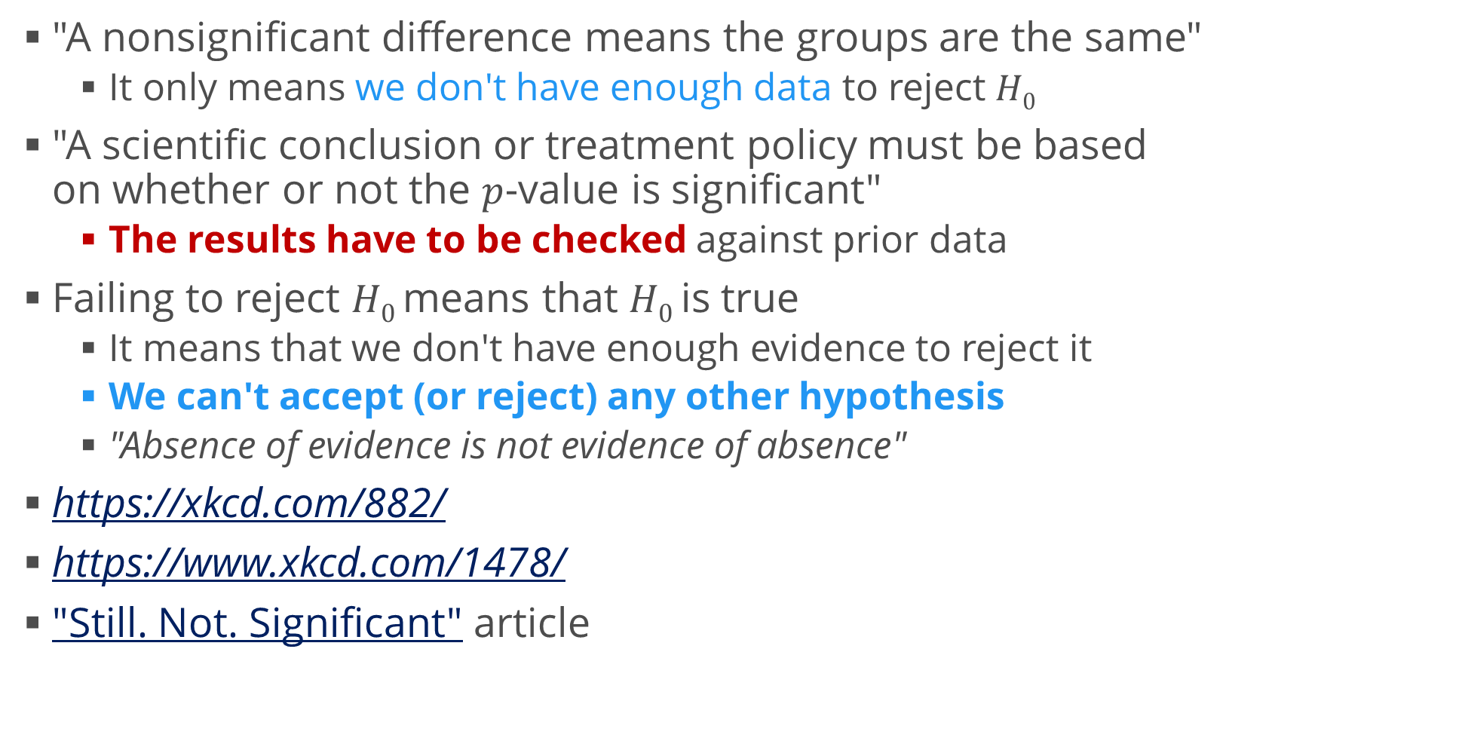
Some p-value Misconceptions (2)
"A nonsignificant difference means the groups are the same"
It only means we don't have enough data to reject $H0$
"A scientific conclusion or treatment policy must be based on whether or not the $p$-value is significant"
The results have to be checked against prior data
Failing to reject $H0$ means that $H0$ is true
It means that we don't have enough evidence to reject it
We can't accept (or reject) any other hypothesis
"Absence of evidence is not evidence of absence"
https://xkcd.com/882/
https://www.xkcd.com/1478/
"Still. Not. Significant" article

Slide 29
Summary
Confidence intervals
Confidence level
Hypothesis tests
Z-test
t-test (one-sample, two-sample)
Hypothesis tests of many variables
ANOVA
Chi-squared
p-value misconceptions

